Slide 1

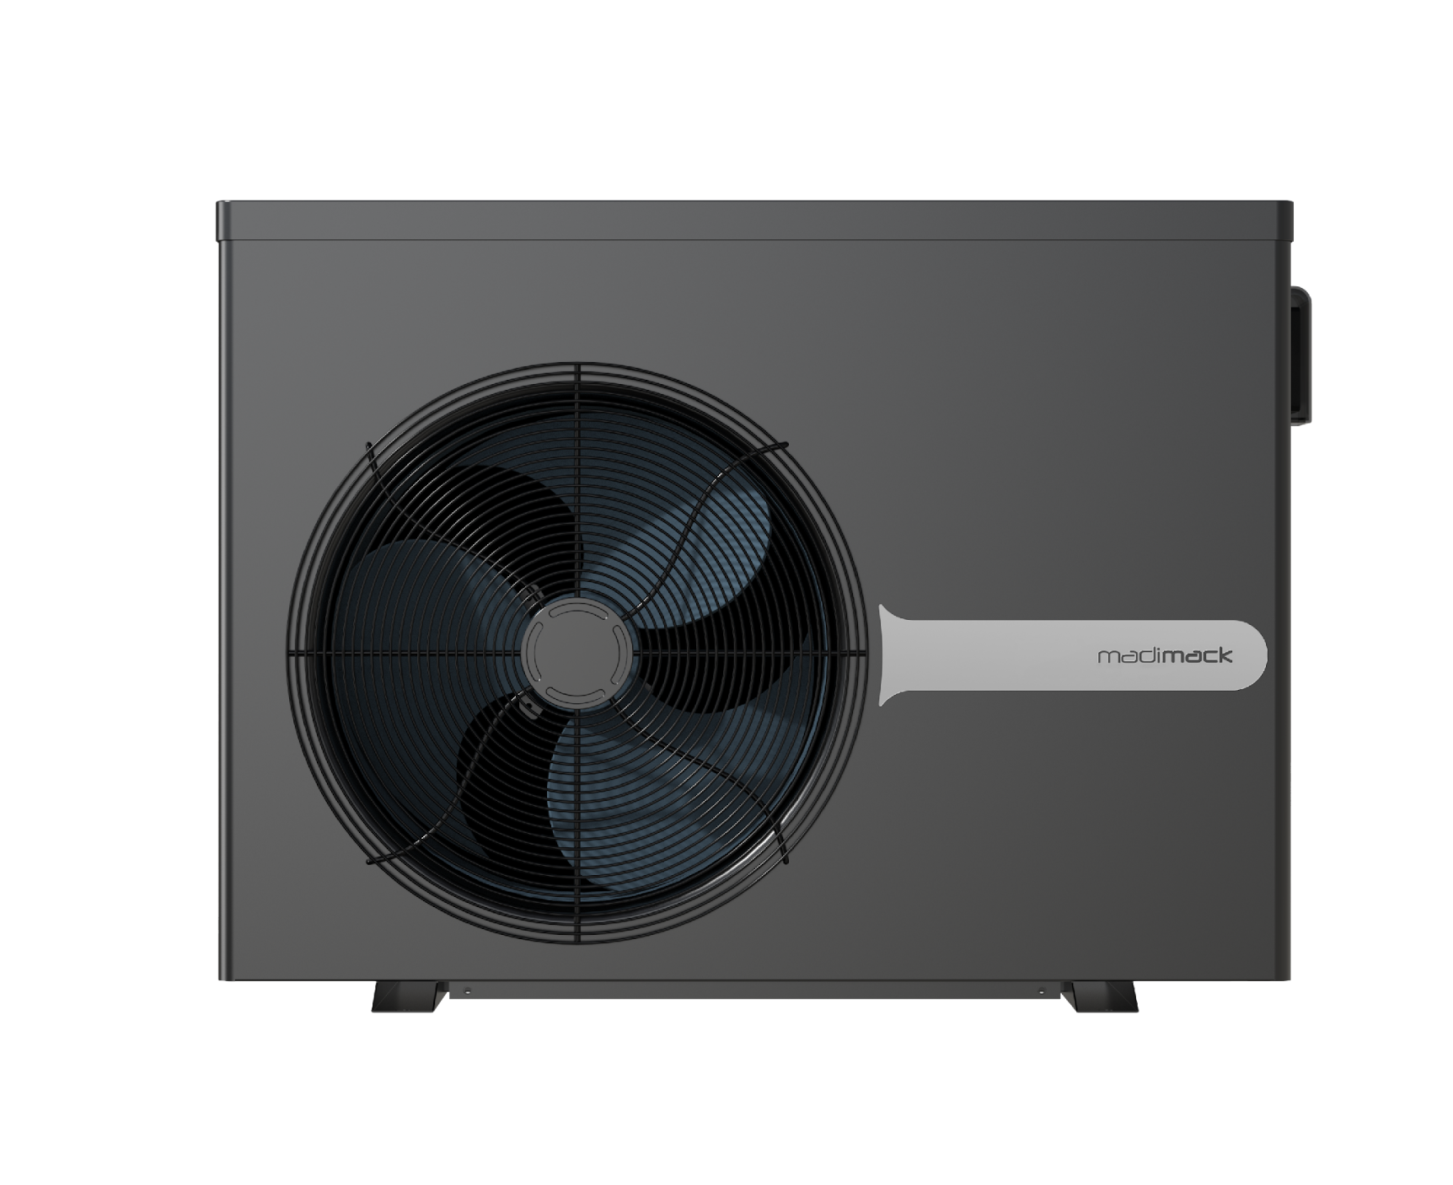

Before replacing the PC board, please adjust the code of the Dip Switch panel according to the model.
1-ON
DIN1 - Closed
AIN 8 - Open
InverECO 320
0-OFF
1
2
3
4
1-ON
DIN1 - Closed
AIN 8 - Open
InverECO 400
0-OFF
1
2
3
4
1-ON
DIN1 - Closed
AIN 8 - Open
InverECO 500
0-OFF
1
2
3
4
1-ON
DIN1 - Closed
AIN 8 - Open
InverECO 660
0-OFF
1
2
3
4
Note: The last pin should be Switch on "1" for heating and cooling units
Note: The first pin should be Switch on "1" for dual fan units

Slide 2
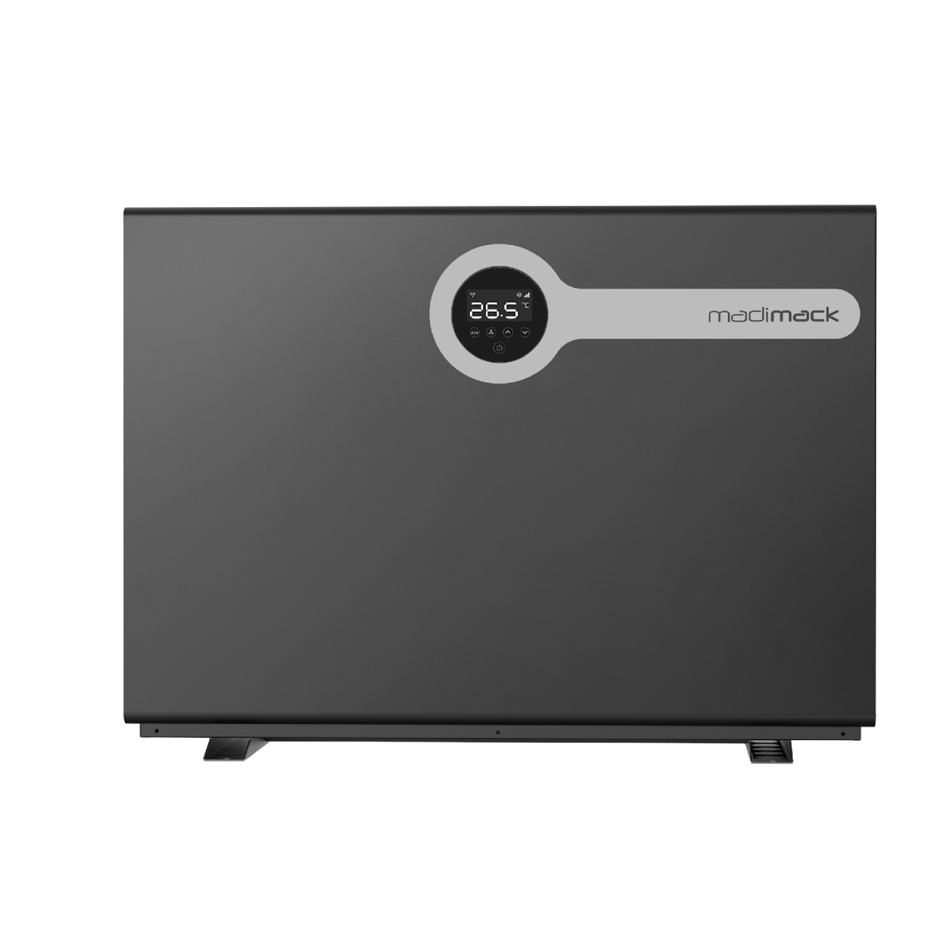

Before replacing the PC board, please adjust the
code of the Dip Switch panel according to the model.
1-ON
DIN1 - Closed
AIN 8 - Open
InverELITE 900
0-OFF
1
2
3
4
1-ON
DIN1 - Closed
AIN 8 - Open
InverELITE 1100
0-OFF
1
2
3
4
Note: The last pin should be Switch on "1" for heating and cooling units
Note: The first pin should be Switch on "1" for dual fan units

Slide 3
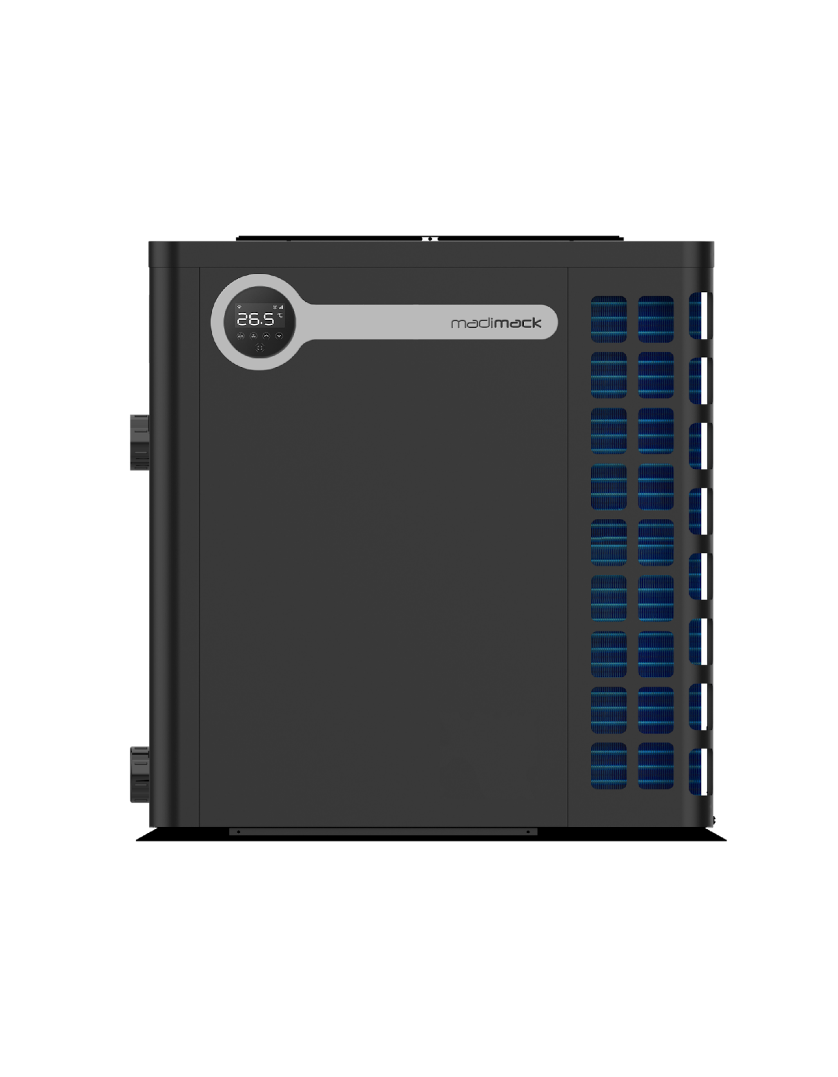

Before replacing the PC board, please adjust the
code of the Dip Switch panel according to the model.
1-ON
DIN1 - Closed
AIN 8 - Open
InverTITAN 090
0-OFF
1
2
3
4
1-ON
DIN1 - Closed
AIN 8 - Open
InverTITAN 112
0-OFF
1
2
3
4
1-ON
DIN1 - Closed
AIN 8 - Open
InverTITAN 140
0-OFF
1
2
3
4
Note: The last pin should be Switch on "1" for heating and cooling units
Note: The first pin should be Switch on "1" for dual fan units

