Slide 1

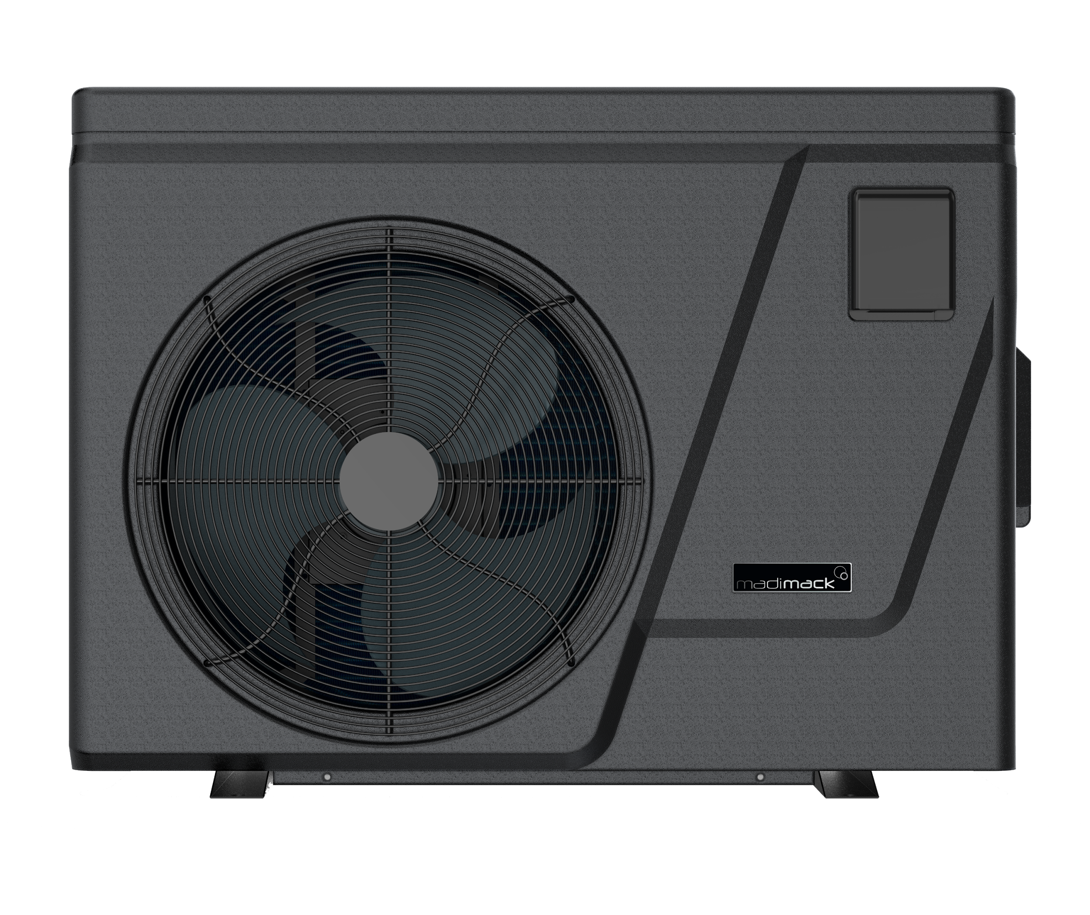

Before replacing the PC board, please adjust the
code of the Dip Switch panel according to the model.
1-ON
SUME090
0-OFF
1
2
3
4
1-ON
SUME0130
0-OFF
1
2
3
4
1-ON
SUME0160
0-OFF
1
2
3
4
1-ON
SUME0200
0-OFF
1
2
3
4
1-ON
SUME0240
0-OFF
1
2
3
4
Note: The last pin should be Switch on "1" for heating and cooling units
Note: The first pin should be Switch on "1" for dual fan units

Slide 2
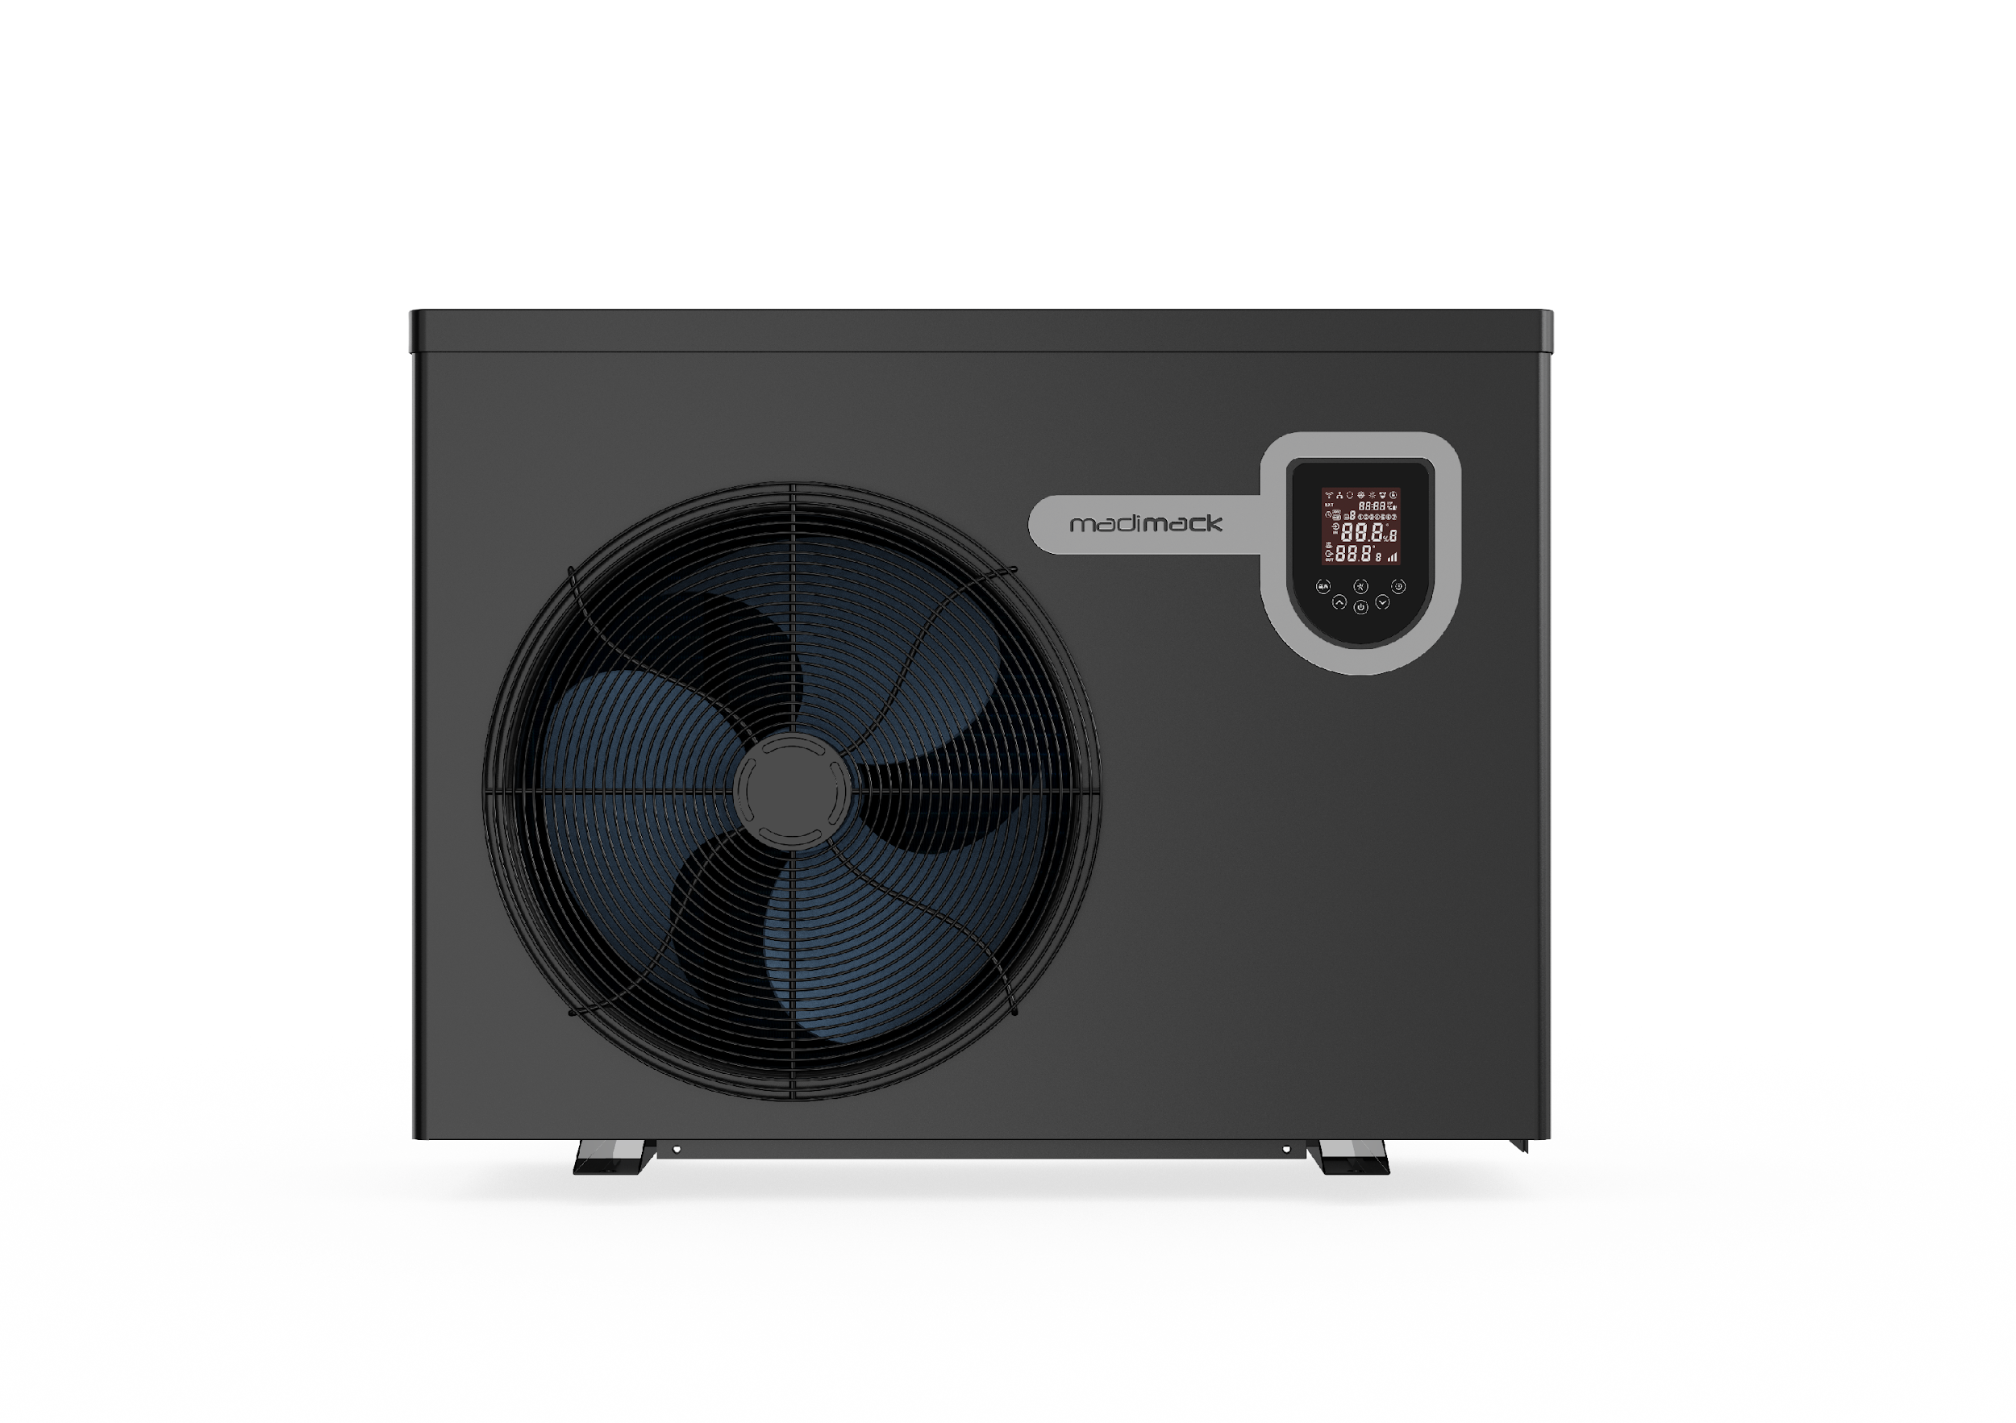


Before replacing the PC board, please adjust the
code of the Dip Switch panel according to the model.
1-ON
ES110
0-OFF
1
2
3
4
1-ON
ES130
0-OFF
1
2
3
4
1-ON
ES170
0-OFF
1
2
3
4
1-ON
ES210
0-OFF
1
2
3
4
1-ON
ES280
0-OFF
1
2
3
4
Note: The last pin should be Switch on "1" for heating and cooling units
Note: The first pin should be Switch on "1" for dual fan units

Slide 3
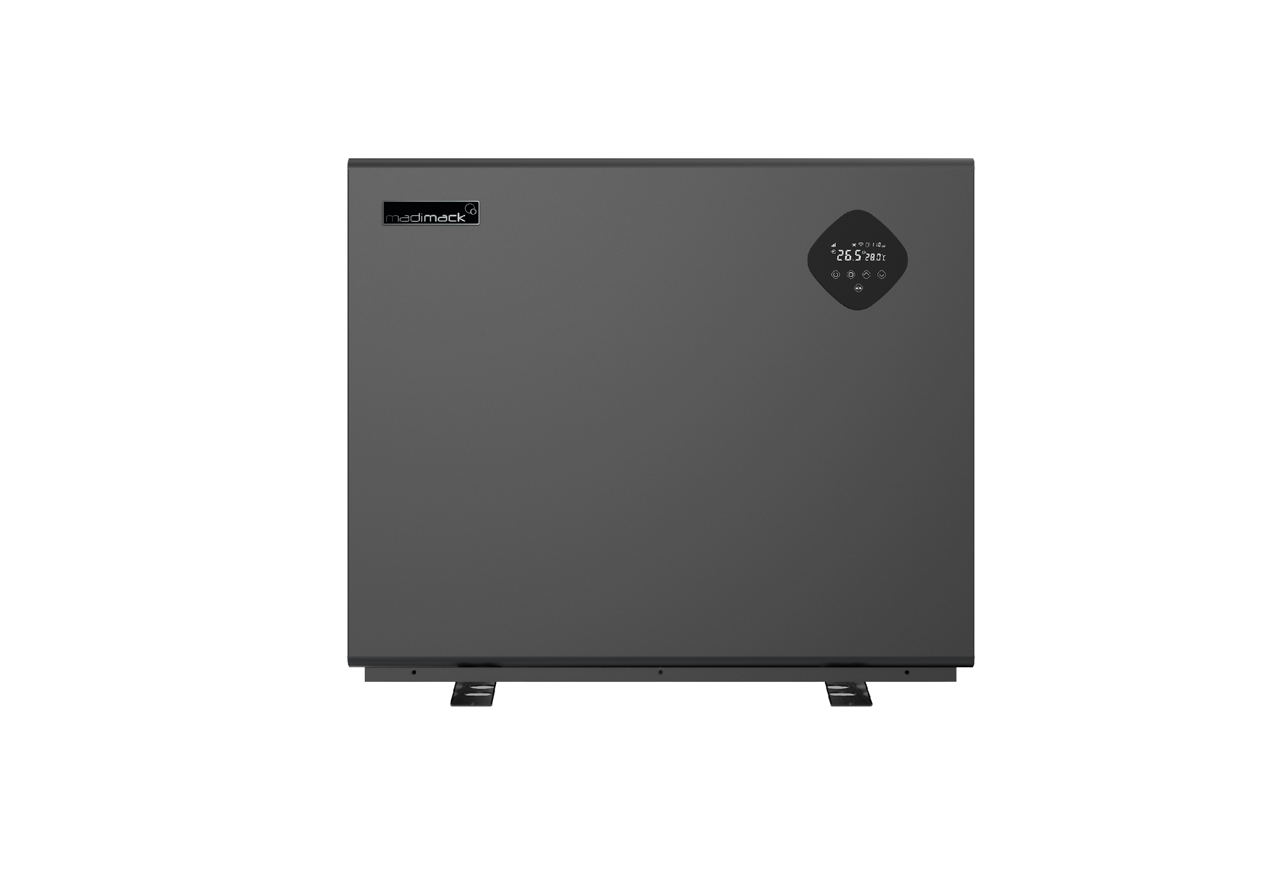

Before replacing the PC board, please adjust the
code of the Dip Switch panel according to the model.
ESV3-110
ESV3-140
1-ON
1-ON
0-OFF
1
2
3
4
5
6
0-OFF
1
2
3
4
5
6
ESV3-170
ESV3-220
1-ON
1-ON
0-OFF
1
2
3
4
5
6
0-OFF
1
2
3
4
5
6
ESV3-270 (pre-May 2022)
ESV3-270 (post-May 2022)
1-ON
1-ON
0-OFF
1
2
3
4
5
6
0-OFF
1
2
3
4
5
6
ESV3-320 (dual fan)
1-ON
0-OFF
1
2
3
4
5
6
7
8
ESV3-400s (dual fan)
1-ON
0-OFF
1
2
3
4
5
6
7
8
Note: The last pin should be Switch on "1" for heating and cooling units
Note: The first pin should be Switch on "1" for dual fan units

Slide 4
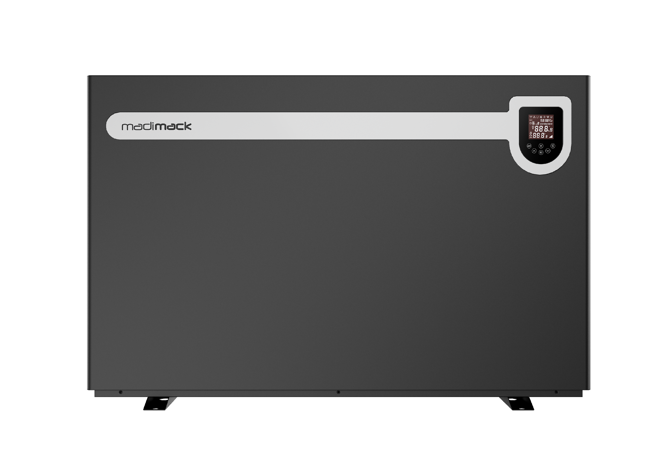

Before replacing the PC board, please adjust the
code of the Dip Switch panel according to the model.
ESV4-110
ESV4-120
1-ON
1-ON
0-OFF
1
2
3
4
5
6
0-OFF
1
2
3
4
5
6
ESV4-140
ESV4-170
1-ON
1-ON
0-OFF
1
2
3
4
5
6
0-OFF
1
2
3
4
5
6
ESV4-190
ESV4-230
1-ON
1-ON
0-OFF
1
2
3
4
5
6
0-OFF
1
2
3
4
5
6
ESV4-270
ESV4-330
1-ON
1-ON
0-OFF
1
2
3
4
5
6
0-OFF
1
2
3
4
5
6
ESV4-410 (dual fan)
1-ON
0-OFF
1
2
3
4
5
6
7
8
Note: The last pin should be Switch on "1" for heating and cooling units
Note: The first pin should be Switch on "1" for dual fan units

Slide 5
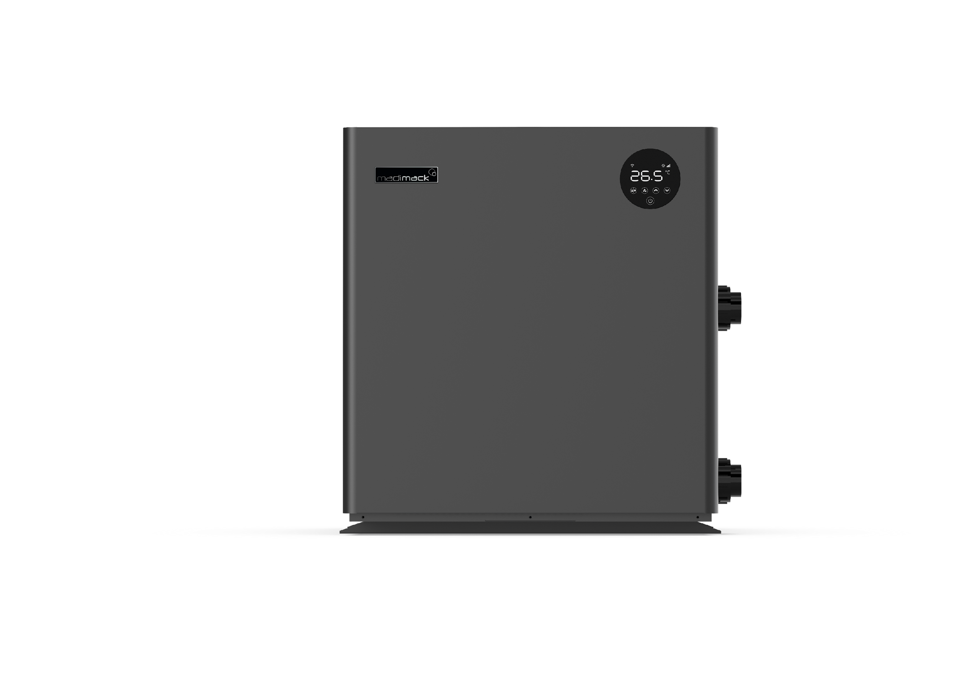
Before replacing the PC board, please adjust the
code o the Dip Switch panel according to the model.
1-ON
ETD-160
0-OFF
1
2
3
4
1-ON
ETD-210
0-OFF
1
2
3
4
1-ON
ETD-260
0-OFF
1
2
3
4
Note: The last pin should be Switch on "1" for heating and cooling units
Note: The first pin should be Switch on "1" for dual fan units

Slide 6

Before replacing the PC board, please adjust the
code of the Dip Switch panel according to the model.
EM600
(Pre June 2022)
1-ON
0-OFF
1
2
3
4
5
6
7
8
EM600
(After June 2022)
1-ON
0-OFF
1
2
3
4
5
6
7
8
EM1200
(Pre June 2022)
1-ON
0-OFF
1
2
3
4
5
6
7
8
EM1200
(After June 2022)
1-ON
0-OFF
1
2
3
4
5
6
7
8
Note: The last pin should be Switch on "1" for heating and cooling units
Note: The first pin should be Switch on "1" for dual fan units

